Slide 1
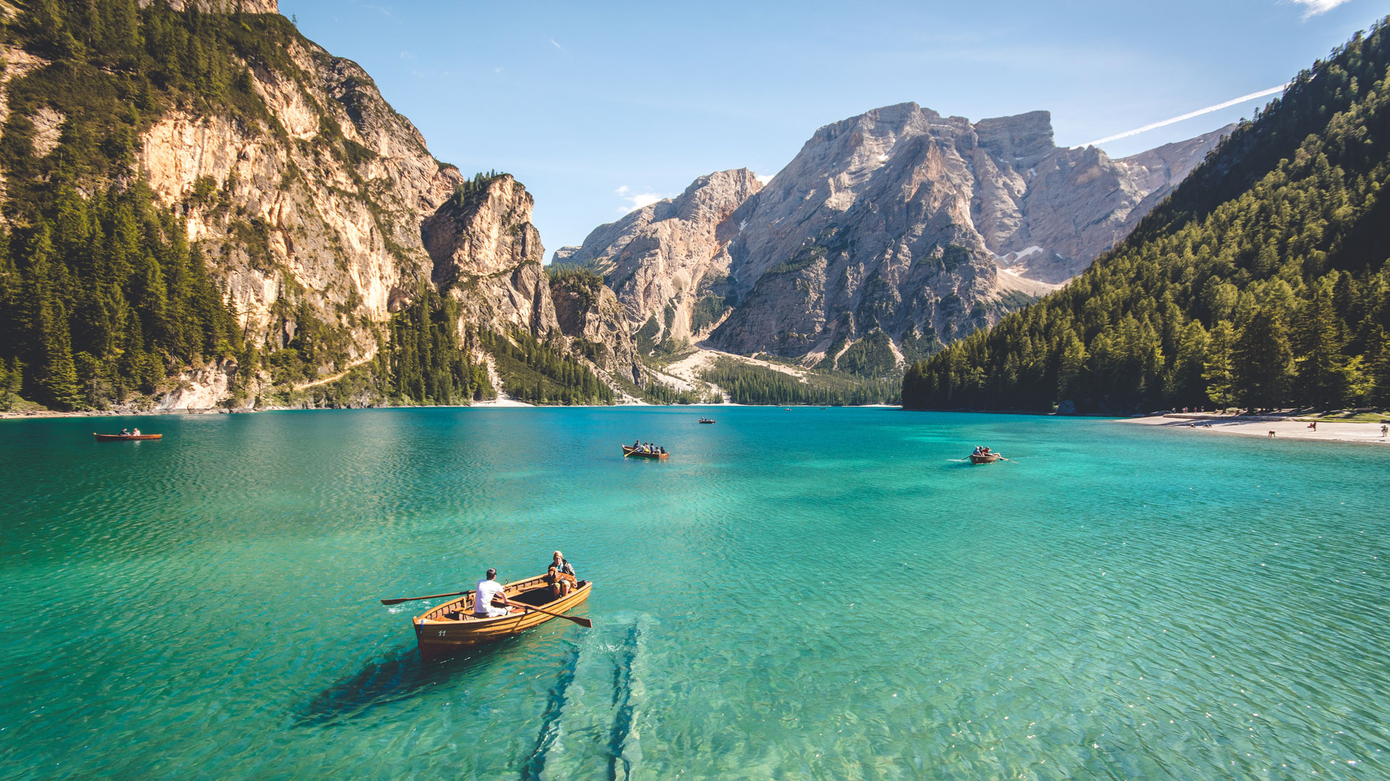
J&Js Getaways
A property booking website
James & Jaden

Slide 2
Initial Idea
A simple website a user could log on to and browse properties from all over the world.
Search based on various factors.
User can then make a booking entering personal information which is saved to the DB.
Customers booking can be retrieved by entering their email & password.

Slide 3
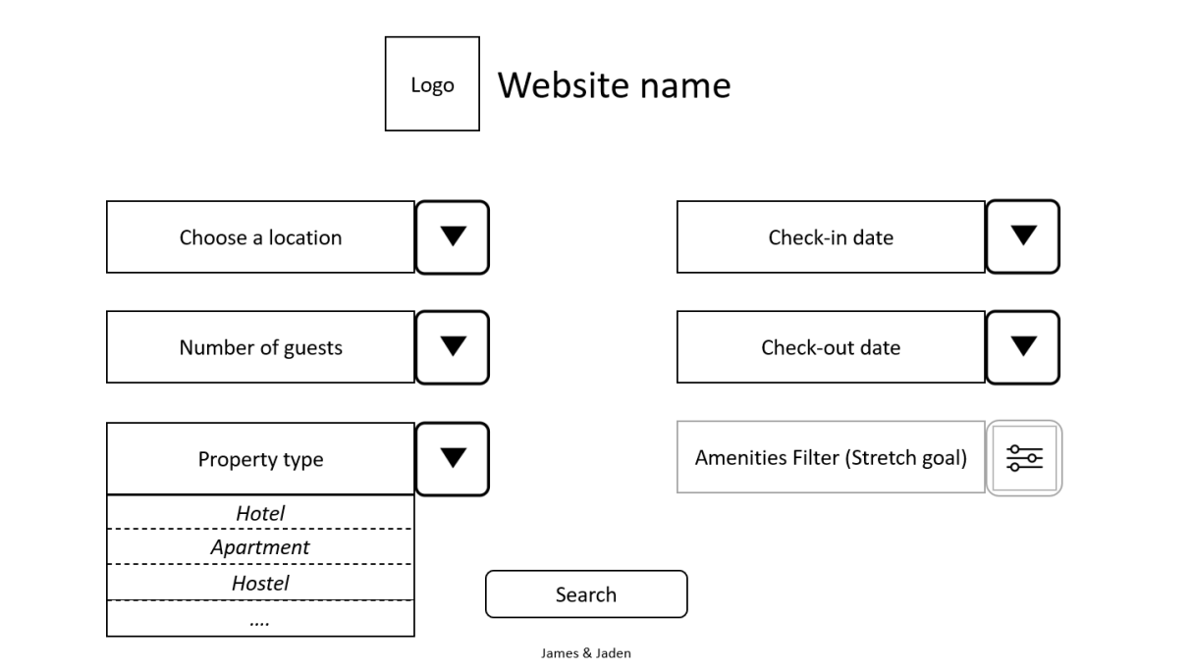
Initial Wireframes

Slide 4
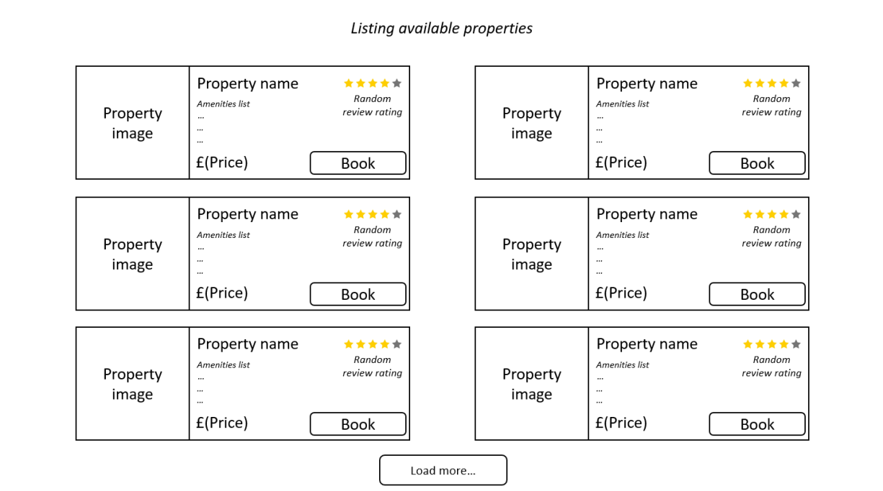

Slide 5
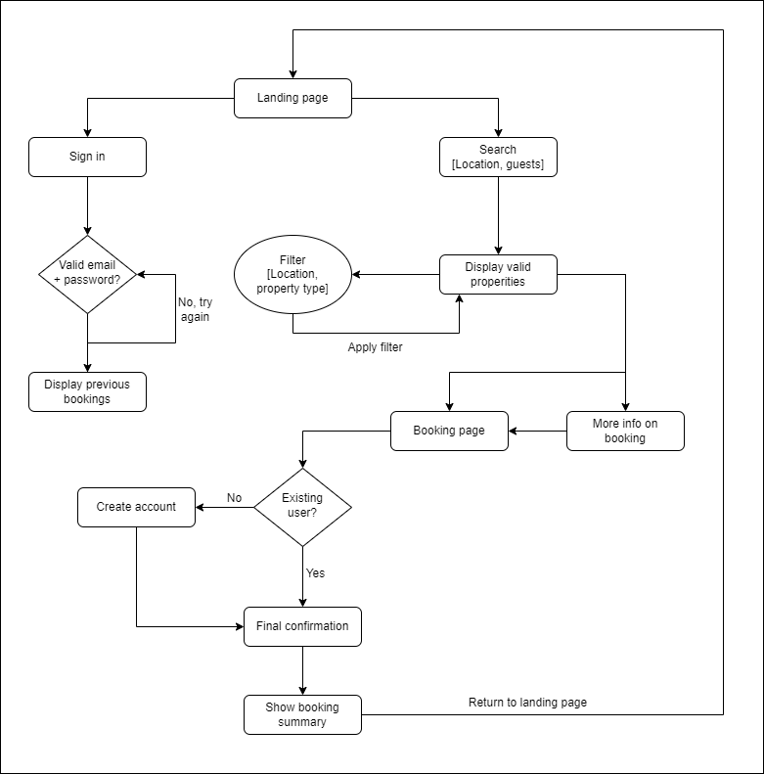
Flowchart

Slide 6
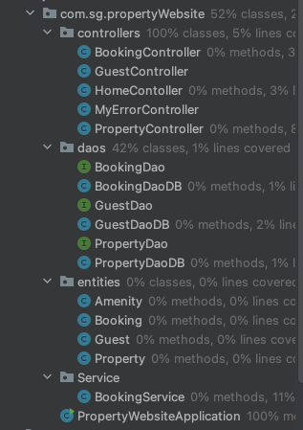
Code Structure & Technology Stack
Java 11
Spring BOOT
JDBC Template
Maven
Thmeleaf
MySQL

Slide 7
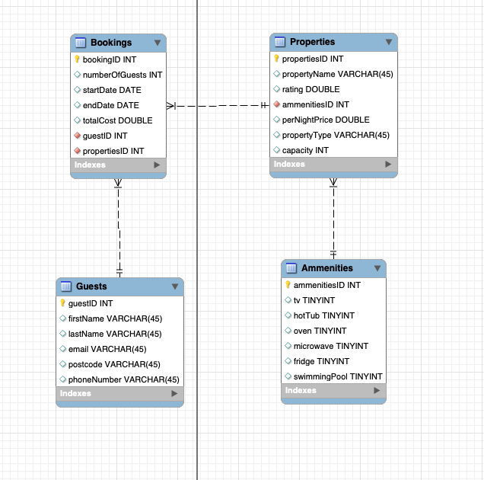
ERD Diagram

Slide 8
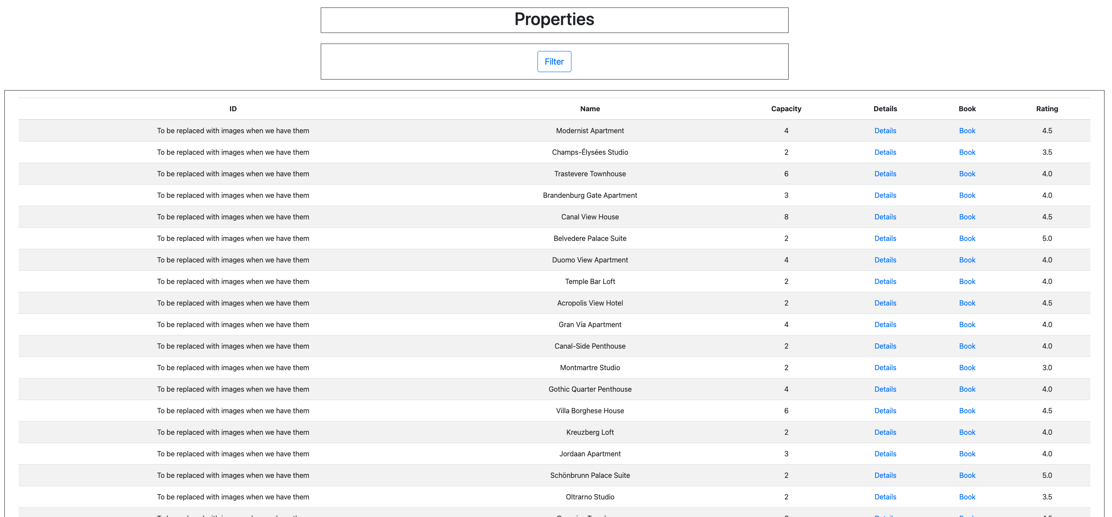
GUI Progress

Slide 9
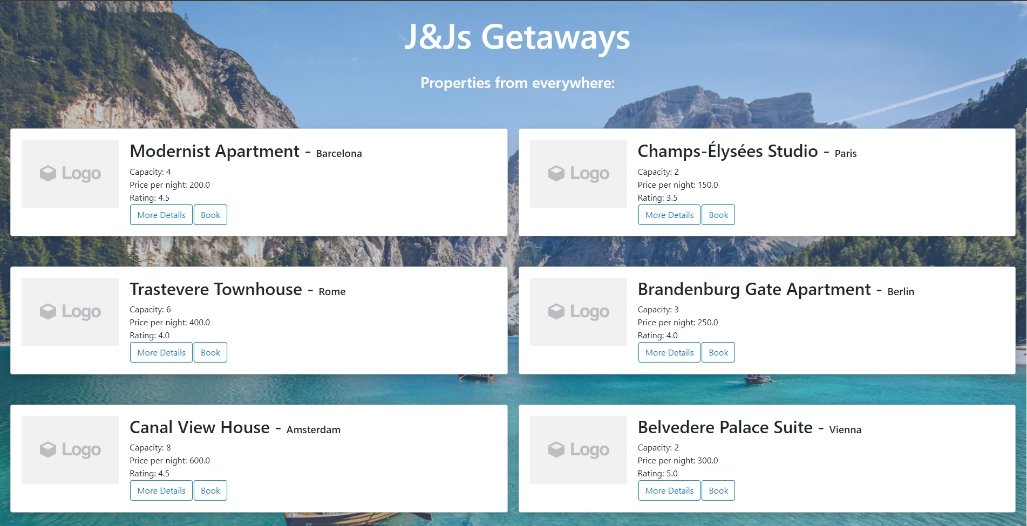

Slide 10
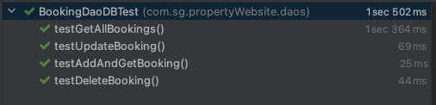
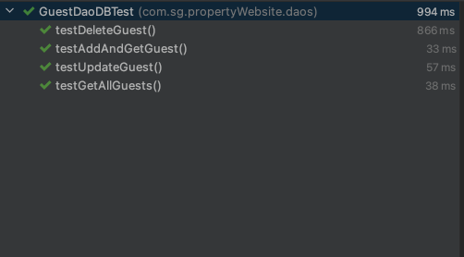
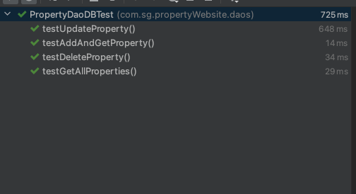
Unit Tests

Slide 11
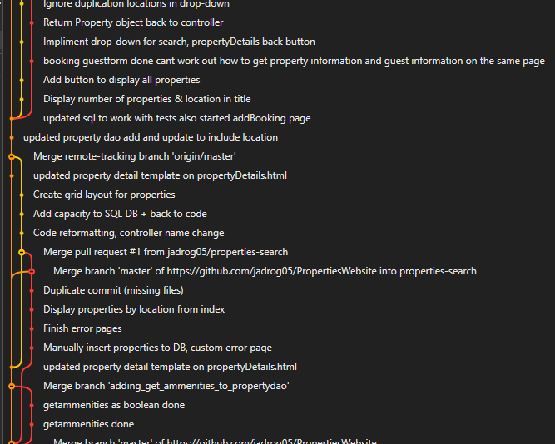
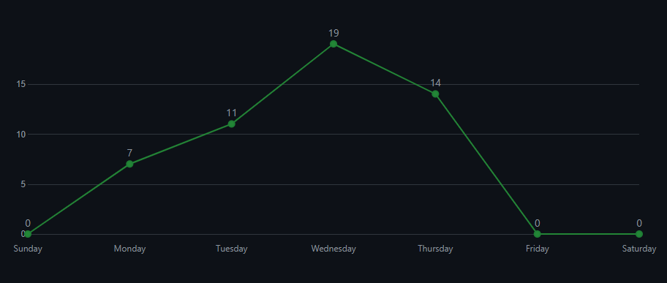
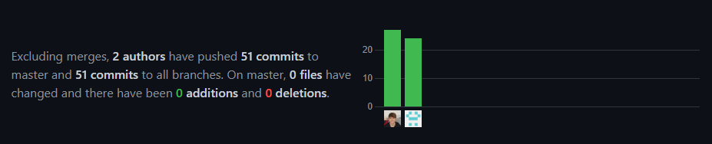
Version Control - Git

Slide 12
Live demo!

Slide 13
Future development
Booking retrieval not working for user with multiple bookings
Secure login page functionality
Amenities filter
Start/end date before search

Slide 14
Questions?

